Slide 1
How to embed public participation in policy-making?
Some reflections
Linda JākobsonE, Think tank Providus
11/06/2018

Slide 2
Be strategic (what is the forest behind a tree?)

Slide 3

Involvement
Growth
Sustainability

Slide 4
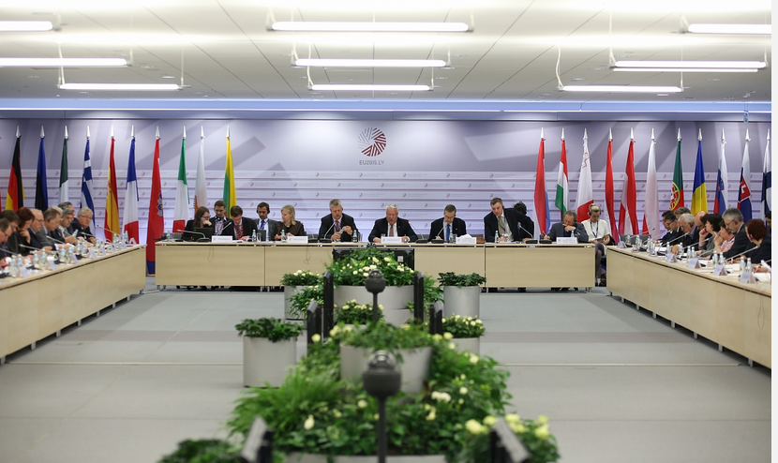
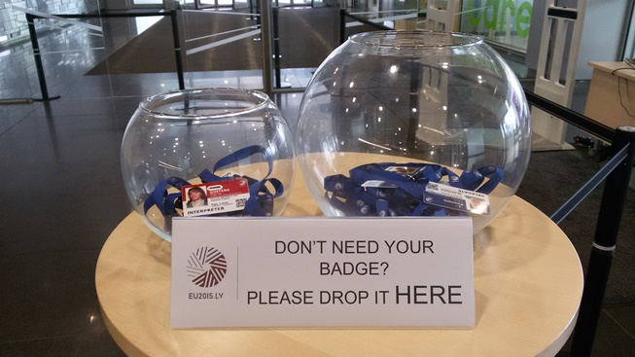
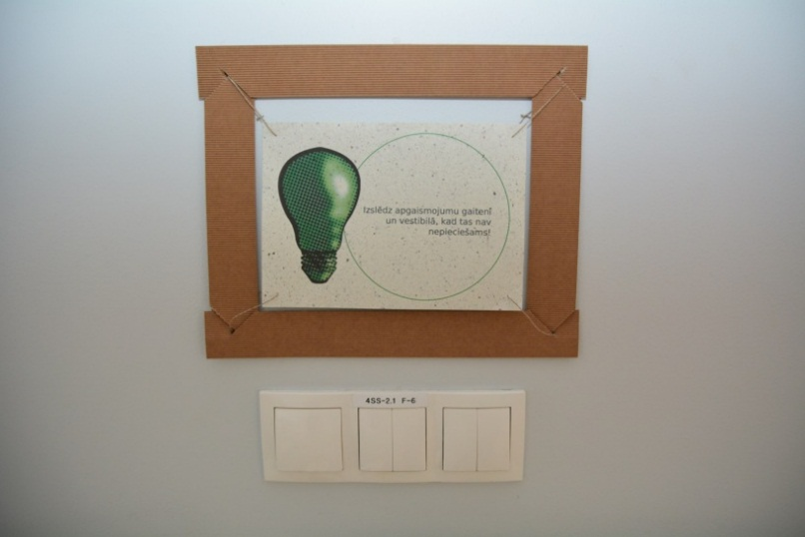
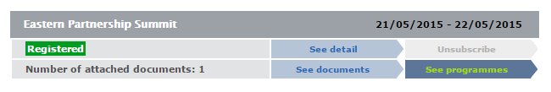
Notes:
Title
Picture

Slide 5
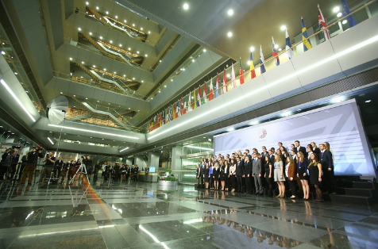
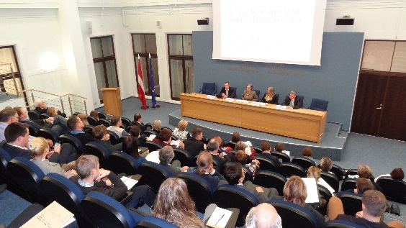
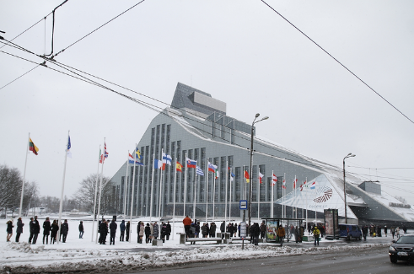
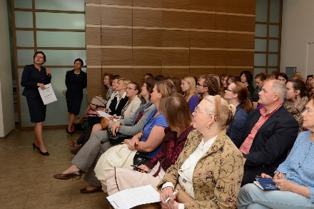
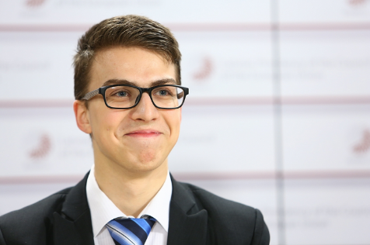
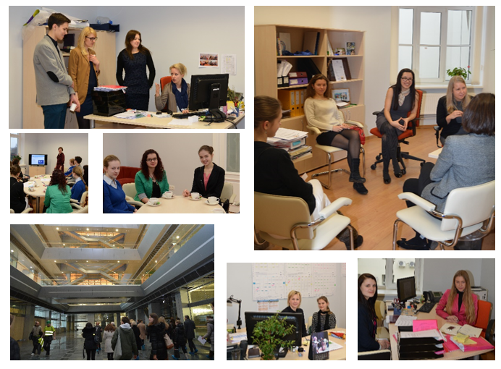

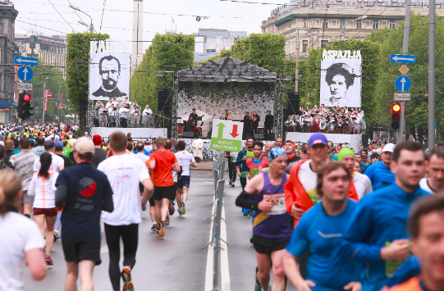
Simulation game for youth
NGOs
Debates and discussions
Kilometre of Culture of Latvian Presidency
Back-to-school and Job shadowing

Slide 6





Castle of Light

Slide 7
Always think of comms

Slide 8
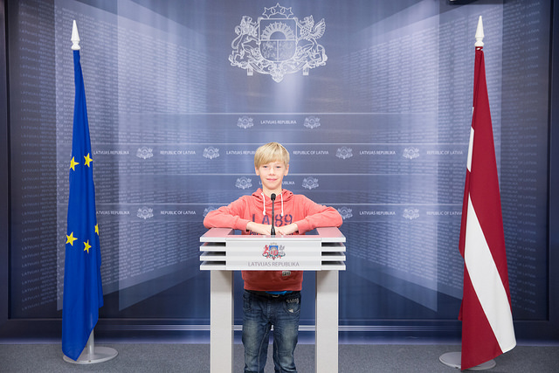

Slide 9
Be transparent and be digital

Slide 10


Slide 11
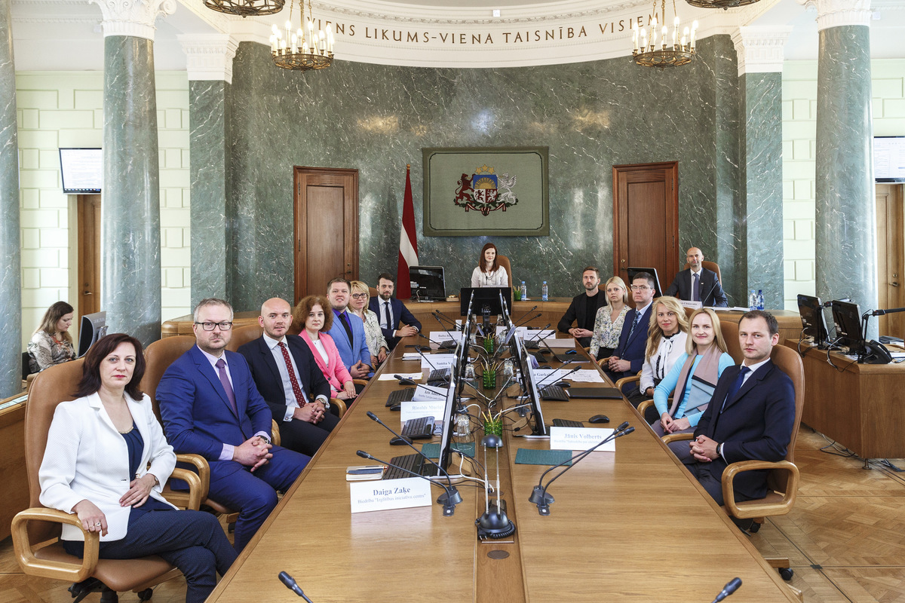
Memorandum of Understanding by the government and the NGOs

Slide 12
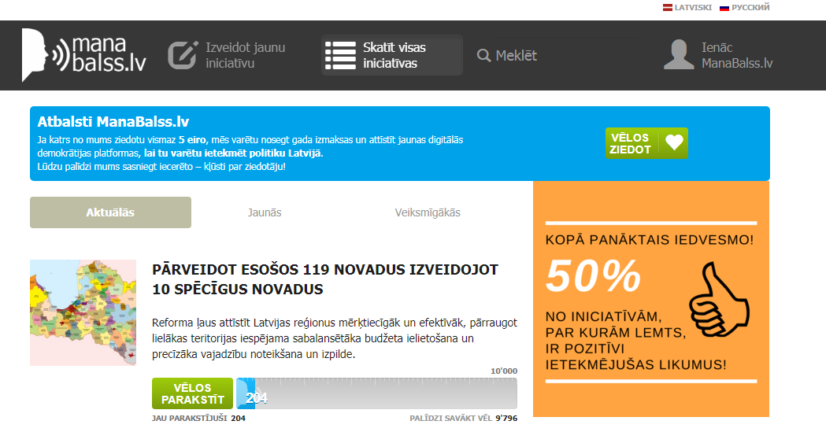

Slide 13
Coordinate

Slide 14
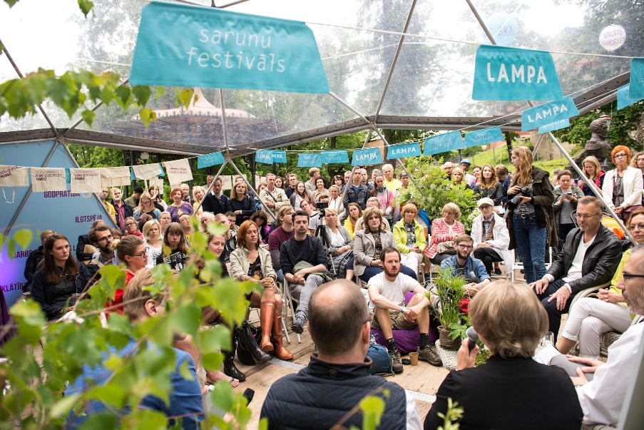


Notes:
Chapter title

Slide 15
Measure and move on

Slide 16
The British model
4. Scoring - evaluation
What did you do before and during the activity?
What is delivered / target audience reached?
What the target audience think, feel or do to make a decision
The result of your activity on the target audience
The quantifiable impact on the organisational goal
INPUTS
OUTPUTS
OUTTAKES
OUTCOMES
ORGANISATIONAL IMPACT
Notes:
ON SCREEN: INPUTS OUTPUTS OUTTAKES OUTCOMES ORGANISATIONAL IMPACT
These are the evaluation measures named in the swatch – inputs, outputs, etc…. And as you see they follow a logical sequence….
The inputs cover what you do before and during your activity. What are the things that you plan and undertake to make your comms happen.
The outputs cover the reach of your comms – how many people in the target audience saw or heard your activity, and how often, and what was delivered by you.
The outtakes cover what the target audience thinks or feels or does in order to make a decision.
The outcomes relate to the result of your activity and what was its impact.
The organisational outcomes tend to be more long term and relate to the contribution that comms has made to the organisational objective.
When we consider our communication activity it can be useful to map out the journey for the target audience as you saw in the journey plan in the pre-course material. This is not an actual journey plan, but it models what we are doing and how the target audience is affected as a linear sequence. The reality is that things don’t happen in a straight line way, but it is helpful for us to model it like that.
So, taking each of these measures in turn….

Slide 17


Slide 18

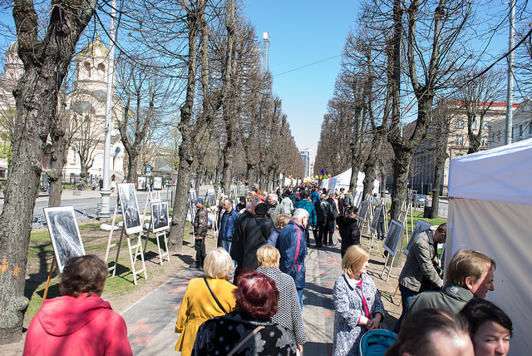

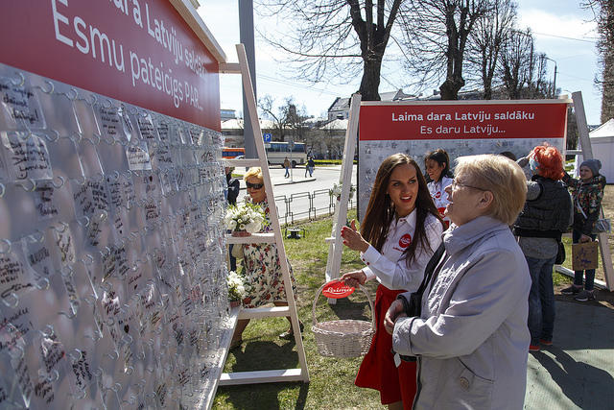

Slide 19

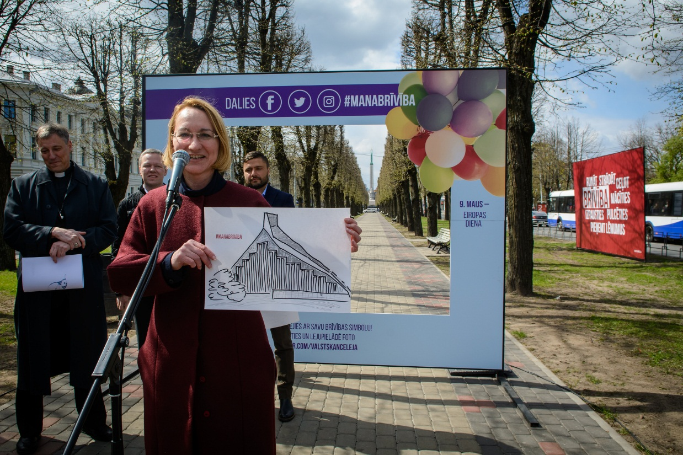

Slide 20
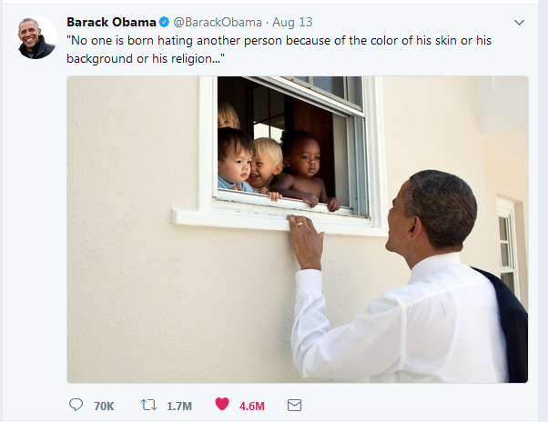
+ always strive for excellence

Slide 21

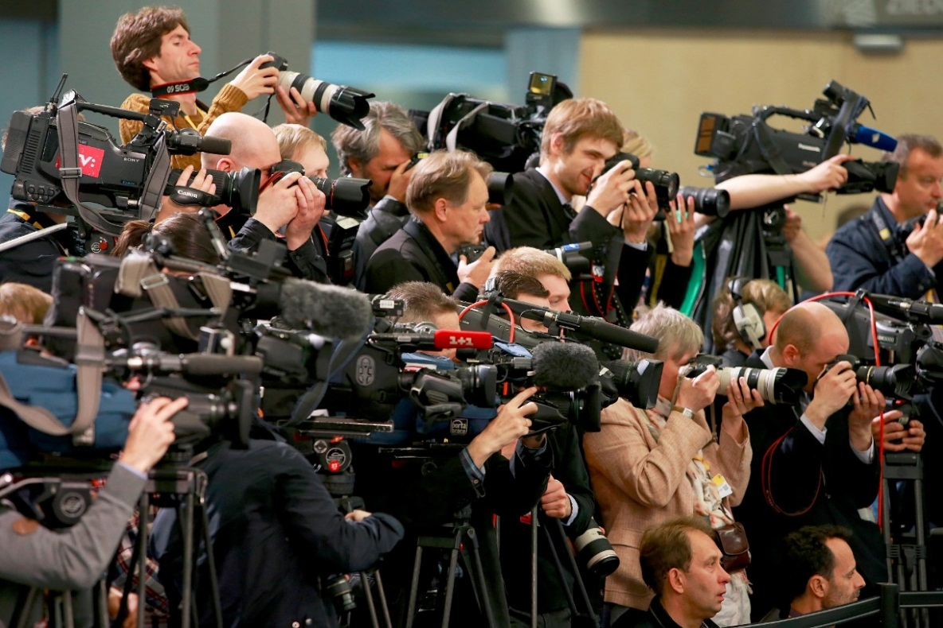
+ enjoy
Notes:
Title
Picture

Slide 22
Linda Jākobsone
Linda.Jakobsone@gmail.com
+371 29123348
photos: Secretariat of the Latvian Presidency of the Council of the European Union, State Chancellery of Latvia, etc.

